Slide 1


Compliance Requirements for Clinical/Fieldwork/
Practicum Experience
Utilizing the Exxat system to record pre-clinical/fieldwork compliance requirements
Updated 3/16/2026

Slide 2
Compliance Requirements In Exxat At a Glance
HEALTH AND IMMUNIZATION
Flu (Influenza)
Hepatitis B (HepB)
Measles, Mumps, Rubella (MMR)
Physical Examination Form
Tetanus, Diphtheria, and Pertussis (Tdap)
Tuberculosis (TB)
Varicella
CERTIFICATIONS
AND TRAINING
HIPAA
Bloodborne Pathogen Training¹
CPR²
FERPA³
First Aid⁴
VERIFICATION / IDENTITY
DOCUMENTS
FBI Fingerprint
PA DHS Child abuse History Clearance ACT 151
PA state police request for criminal records (PATCH) Act 34
Universal - Background Standard
Universal-New York Statewide Screening (if applicable)
Universal - Drug Screen⁵
OTHER
Health Insurance
License (DNP only)
Student Handbook (BSN/ABSN/DNP only)
Temple University Health System Mandatory Compliances (BSN/ABSN/DNP only)
1 – DNP, BSN, ABSN,DPT, MPH Nutrition, ESS, DOT, MSAT, MSRT, BSRT, SLH, EMT course only
2 – DNP, BSN, ABSN, DPT, DOT, MSAT, MSRT, BSRT, EMT course only
3 – DPT, MPH Nutrition, MSAT, ESS, DOT, MSRT, BSRT, SLH, BSPH, EMT course, MPH-BIO, MPH-EPI, MPH-ENV, MPH-HPM, MPH-SBS only
4 – DPT only
5 – Required for DNP, BSN, ABSN, and DPT programs only, but may be required by sites.

Slide 3
Compliance Requirements At a Glance
HEALTH AND IMMUNIZATION
Requirement | Frequency | Notes | Cost
FLU | Annual | Submit for year between 8/1 and 10/15 | *
Hep B | Fully vaccinated and proof of immunity | N/A | *
MMR | Fully vaccinated OR proof of immunity | 2 documented vaccinations OR Positive (Quantitative)titer for all 3 components | *
Physical | 1x / additionally if required by site | N/A | *
TDAP | Fully vaccinated within last 10 yrs | N/A | *
TB | Once Affiliate may require annual | Annually, 1-step OR 2-step PPD OR QuantiFERON Gold is accepted. | *
Varicella | Fully vaccinated OR proof of immunity | 2 documented vaccinations OR Positive (Quantitative) titer | *
Pre-matriculation Requirements
* See costs of immunizations offered through TU SHS.
https://studenthealth.temple.edu/appointments/prices
May be covered through insurance
For all Health and Immunization Requirements, upload the Student Health Services Summary Sheet to Exxat

Slide 4
Compliance Requirements At a Glance
CERTIFICATIONS AND TRAINING
Requirement | Frequency | Notes | $
Bloodborne Pathogen Training¹ | Annual | N/A | Free
CPR² | As valid (2 year term) **Program will define which training is required | American Heart Association (AHA) accepted, may accept other trainings such as American Red Cross. Check Exxat for details | Varies
FERPA³ | Annual | N/A | Free
HIPAA | Annual | N/A | Free
Sites may require additional onboarding training
1 – DNP, BSN, ABSN,DPT, MPH Nutrition, ESS, DOT, MSAT, MSRT, BSRT, SLH, EMT course only
2 – DNP, BSN, ABSN, DPT, DOT, MSAT, MSRT, BSRT, EMT course only
3 – DPT, MPH Nutrition, MSAT, ESS, DOT, MSRT, BSRT, SLH, BSPH, EMT course, MPH-BIO, MPH-EPI, MPH-ENV, MPH-HPM, MPH-SBS only

Slide 5
Compliance Requirements At a Glance
BACKGROUND AND IDENTITY VERIFICATION
Requirement | Frequency | Notes | $
FBI Fingerprinting | 1x – accepted for 5 years – unless required more frequently by an affiliate | Enter Temple University as Employer Name | $26.40 *
PA DHS Child abuse History Clearance ACT 151 | 1x – accepted for 5 years – unless required more frequently by an affiliate | Only if you are at an affiliate site in the state of Pennsylvania | $13
PA state police request for criminal records (PATCH) Act 34 | 1x – accepted for 5 years – unless required more frequently by an affiliate | Only if you are at an affiliate site in the state of Pennsylvania | $22
Universal - Background Standard | 1x – accepted for 5 years – unless required more frequently by an affiliate | N/A | $58
Universal - New York Statewide Screening (if applicable) | Only if NY resident in last 7 years 1x – accepted for 5 years – unless required more frequently by an affiliate | N/A | $108
Universal - Drug Screening | Only if requested by site | N/A | $25 / $29 †
* Out of state prices may vary. Prices are set by local and federal agencies and may be subject to change.
† $25 through Temple Employee Health, $29 through Universal at any Labcorp or Quest location

Slide 6
Compliance Requirements At a Glance
YEAR | Health & Immunization | Certifications & Training | Verification / Identity | Other
Initial | PREMATRICULATION 1. Flu (Influenza) 2. Hepatitis B (HepB) 3. Measles, Mumps, Rubella (MMR) 4. Physical Examination Form 5. Tetanus, Diphtheria, and Pertussis (Tdap) 6. Tuberculosis (TB) 7. Varicella | [Bloodborne Pathogen Training] [CPR] [FERPA] 8. HIPAA | BEFORE CLINICAL/ PRACTICUM/FIELDWORK 9. Fingerprints 10. PA DHS Child Abuse History Clearance 11. PA state police request for criminal records (PATCH) Act 34 12. Universal - Background Standard [Universal - New York Statewide screening (if applicable)] [Universal - Drug Screening (10 Panel)] | 13. Health Insurance
Annually after first year | Flu (Influenza) TDAP – if >10 yrs * Additional vaccinations/physical may be requested by some sites | [Bloodborne Pathogen Training] [CPR] [FERPA] HIPAA | *Universal - Drug Screening (10 Panel) If requested by site Fingerprints – PA/NJ DoE SLH Only * Additional background checks may be requested by some sites | Health Insurance
Requirements shared by all CPH programs are numbered, requirements limited to certain programs, sites, or states of residency are listed in brackets

Slide 7
EXXAT, PRISM, and Approve
We use Exxat PRISM to record clinical activity at Temple
  Mostly we refer to the product as “Exxat”
  Exxat is the company that offers the current version of its software, PRISM, as well as some other products you will not likely encounter as a student. “Approve” is the name of their compliance review service
In addition to storing compliance documentation, the Exxat system is used for forms/evaluations and timesheets

Slide 8
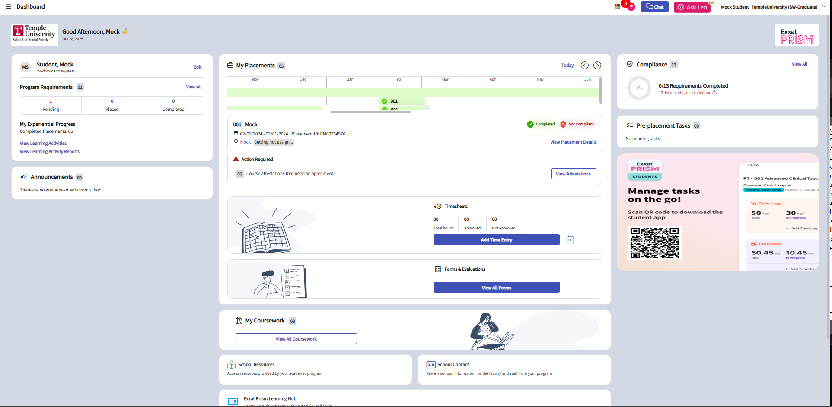
EXXAT
Log in at https://login.exxat.com, or https://prism.exxat.com
Click on “View All” under “Compliance” in the top right
You will be prompted to pay the Approve service annual $35 fee
If you cannot login, email cahelp@temple.edu

Slide 9
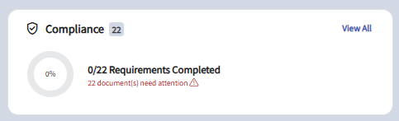
Uploading Compliance Documents to Exxat 1/5
1. Log in and from your dashboard, click on “View All” in the Compliance card. The card indicates items that need your attention.
2. You will be redirected to the Compliance section where you will see a table with all items your program has requested you to upload. You will see any of the following statuses for each item:
a. Get started: you have not yet started working on this item.
b. In progress: you have begun filling your information for this item, but nothing has been submitted to the school.
c. Pending Review: the document has been submitted to your school.
d. Approved: the document has been reviewed by your school and it meets all requirements.
e. Not Approved: the document has been reviewed by your school and determined that it does not meet the requirements.
f. Expiring: an approved document on file is expiring.
g. Expired: the document has expired.

Slide 10
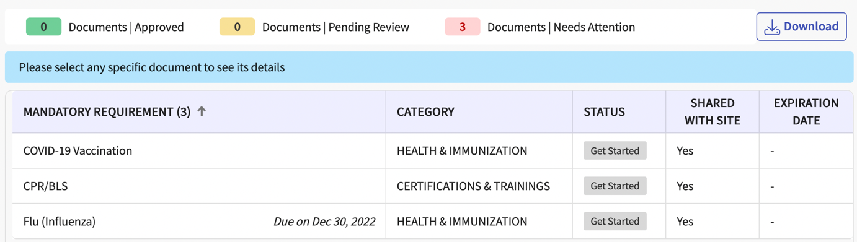
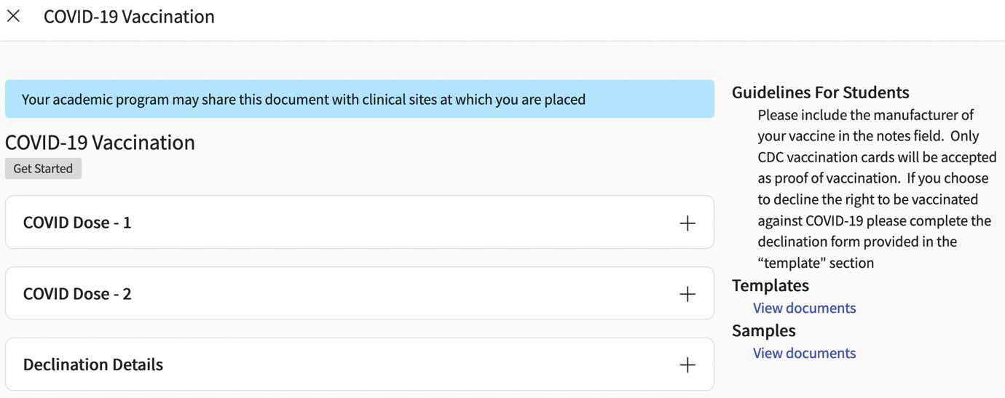
Uploading Compliance Documents to Exxat 2/5
3. Click anywhere on the row for the item you’d like to manage.
**Upload the SHS Summary form (next section) from Temple Student Health to all Health/Immunization Requirements
4. After selecting a document, a drawer will open and it will display the guidelines for your compliance requirement, a template or sample document (if provided), and any information you have previously uploaded. Please review these items before moving on.
Ex. of a Vaccination requirement. Covid-19 in particular is no longer required unless specifically required by the site (including most Temple placements).

Slide 11
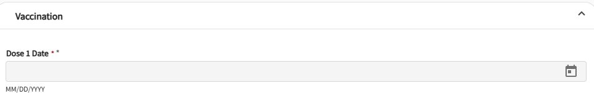
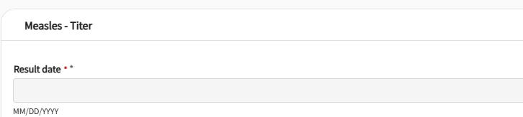
Uploading Compliance Documents to Exxat 3/5
i. You may see the following options:
a. Vaccination
b. Titer Details: Can be used if you have titer information rather than vaccination details.
5. To begin uploading a document and completing the information for a requirement, click on the plus (+) icon next to the document name. To edit an existing item, click the pencil icon.

Slide 12
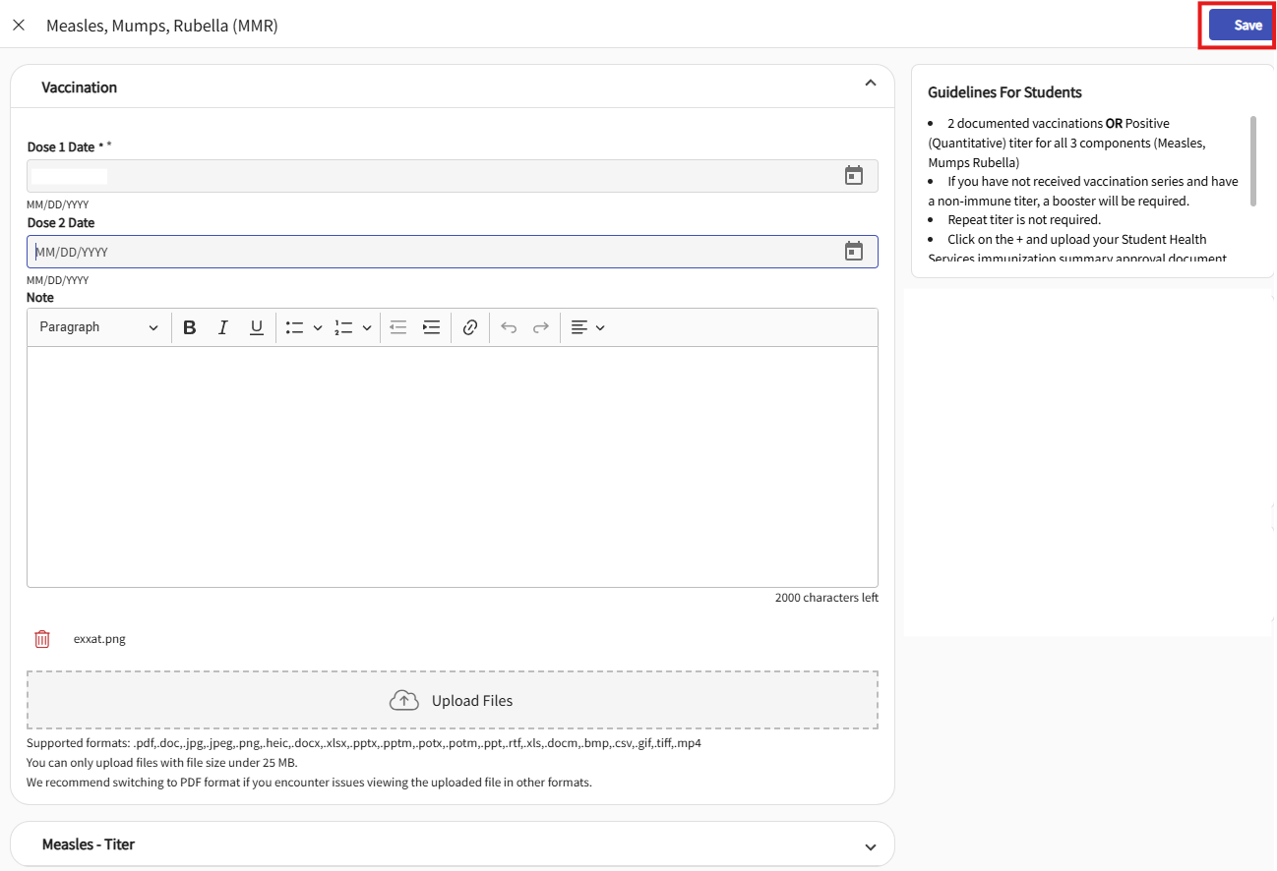
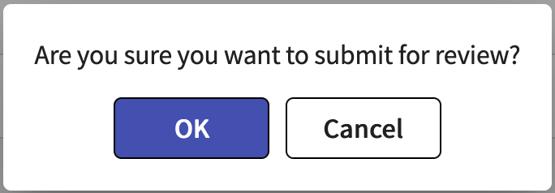
Uploading Compliance Documents to Exxat 4/5
6. Another drawer will open asking for additional details and allowing you to drag and drop a file to be uploaded. Alternatively, you may click on the cloud button to search for a file to upload.
7. After you have completed all required fields, click Save or
Submit for Review.
8. You will be asked to confirm your submission. Click OK.

Slide 13
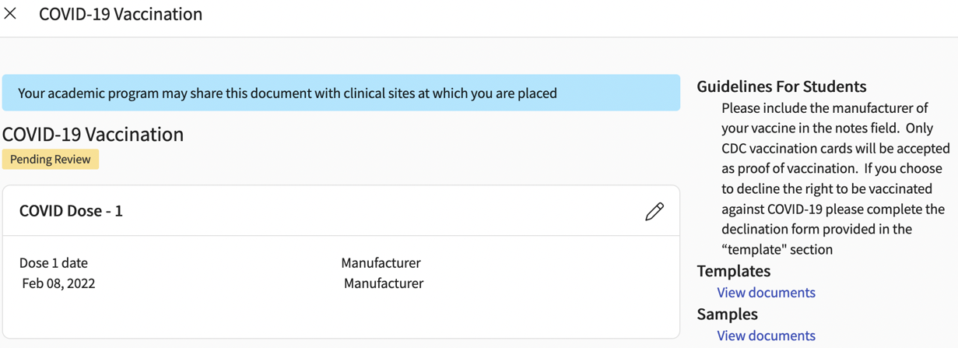
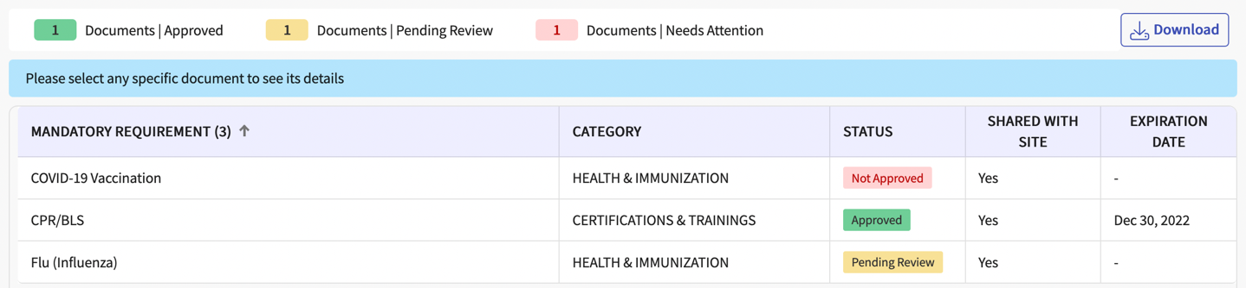
Uploading Compliance Documents to Exxat 5/5
9. The drawer will close, and you will see the status of the item you are working on change to Pending Review.
Once you submit a document for approval, keep returning
to check the status of your requirements. When your
school has reviewed the document, it will change to:
a. Not approved: your document will include a status,
and once selected will show you details as to why your
document has not been approved. Click on the pencil
icon to make the needed changes and/or upload a new document.
b. Approved: you are good to go!

Slide 14
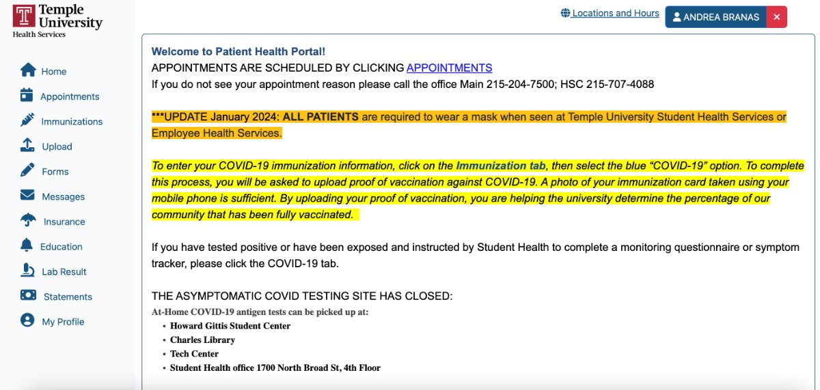
Student Health Portal
https://shs-portal.temple.edu/login.aspx

Slide 15
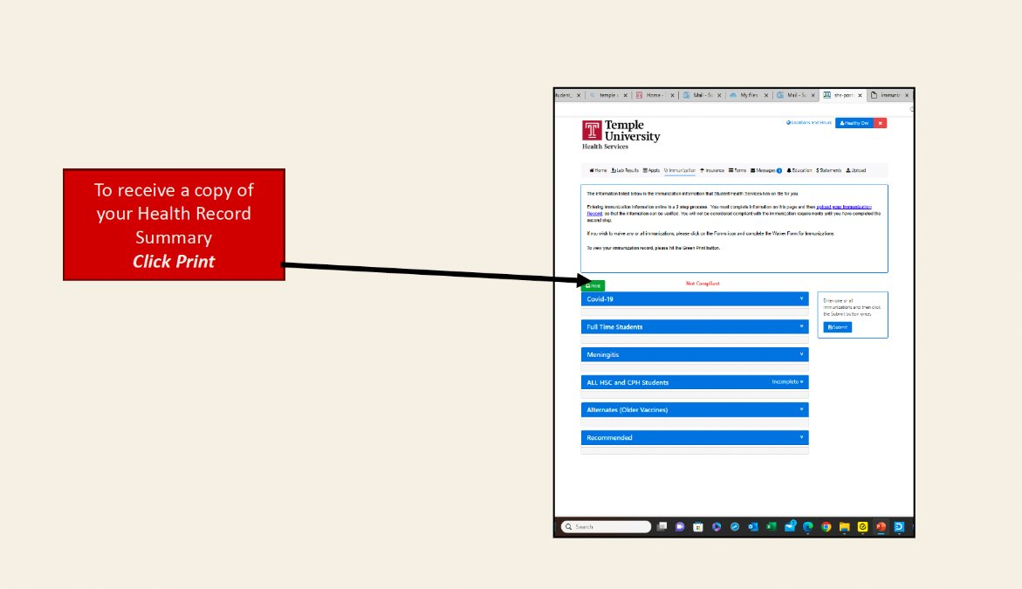
Student Health Portal
Accessing your Health Record Summary
To receive a copy of your Health Record Summary
Click Print

Slide 16
Student Health Portal
Accessing your Health Record Summary
To receive a copy of your Health Record Summary
Click Print

Slide 17
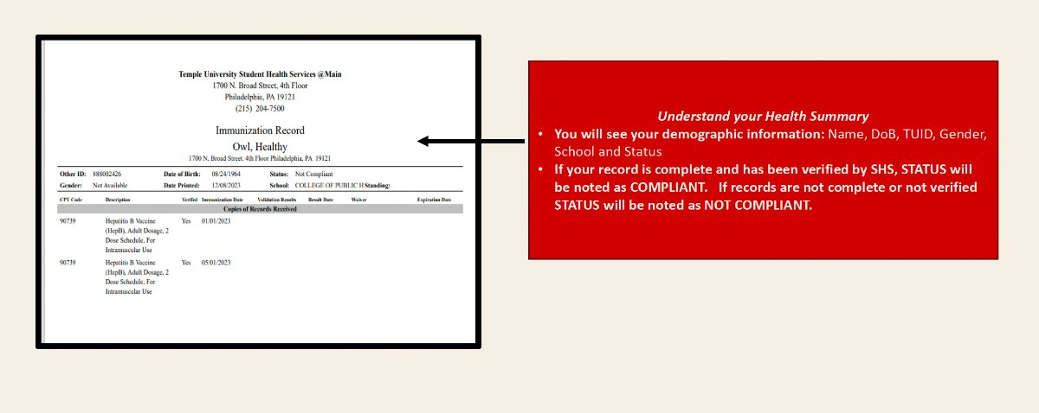
Student Health Portal
Understanding your Health Summary
Understand your Health Summary
You will see your demographic information: Name, Dob, TUID, Gender, School, and Status
If your record is complete and has been verified by SHS, STATUS will be noted as COMPLIANT. If records are not complete or not verified STATUS will be noted as NOT COMPLIANT

Slide 18
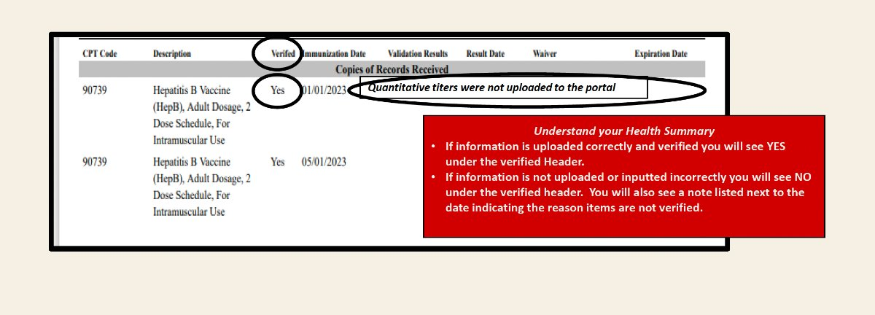
Student Health Portal
Understanding your Health Summary – Validation Results
Understand your Health Summary
If information is uploaded correctly and verified you will see YES under the verified Header.
If the information is not uploaded or inputted incorrectly you will see NO under the verified header. You will also see a note listed next to the date indicating the reason items are not verified.
If you are in any category​
Check to see that any/all information is uploaded correctly​
Contact student health services for any medical follow-up
Not Approved

Slide 19
Requirement Details

Slide 20

Health and Immunization

Slide 21
Health and Immunization Requirements
Pre-matriculation requirements: https://studenthealth.temple.edu/hsc-cph-students-0
All of these records should be uploaded to the Patient Health Portal (https://shs-portal.temple.edu/login.aspx) under the Upload Section.
The SHS Health Summary (Immunization Record) Form (see directions p. 9-12) should be uploaded for all Health and Immunization requirements. A provider form will not be accepted. The same form can be uploaded for all requirements.
List of SHS prices available at https://studenthealth.temple.edu/appointments/prices
Many are covered by insurance and many may be addressed with childhood immunization records

Slide 22
Flu (Influenza)
Flu vaccine must be received no earlier than August 1st of the calendar year and no later than October 15th of every flu season annually.
Flu shots are offered free each fall through TU SHS
The SHS Health Summary (Immunization Record) Form (see directions p. 9-12) should be uploaded for all Health and Immunization requirements. A provider form will not be accepted.
Upload documentation of flu vaccination for current flu season.
Annual Requirement

Slide 23
Hepatitis B
You are required to demonstrate immunity to Hepatitis B
This should be guided by the student health services.
3- dose of Engerix-B, Recombivax or Tinrix OR 2-dose Heplisav-B AND Positive Antibody (Quantitative) titer
The SHS Health Summary (Immunization Record) Form (see directions p. 9-12) should be uploaded for all Health and Immunization requirements. A provider form will not be accepted.
Hepatitis B antigen report is not accepted.

Slide 24
Measles, Mumps, and Rubella
You are required to demonstrate immunity to MMR
2 documented vaccinations OR Positive (Quantitative) titer for all 3 components
The SHS Health Summary (Immunization Record) Form (see directions p. 9-12) should be uploaded for all Health and Immunization requirements. A provider form will not be accepted.

Slide 25
Physical Exam Form
Must be completed by the health care provider, signed and dated.
School form provided to student for completion (in Exxat and on SHS site)
SHS summary approval document or physical form on TU template can be accepted.
Physical should be completed pre- matriculation and does not need to be repeated unless otherwise specified by an affiliate contract.

Slide 26
Tetanus, Diptheria, and Pertussis (TDAP)
Tdap Booster within 10 years
Must include pertussis; Td not accepted.
Expiration date will be auto-filled as per the school guidelines
The SHS Health Summary (Immunization Record) Form (see directions p. 9-12) should be uploaded for all Health and Immunization requirements. A provider form will not be accepted.

Slide 27
Tuberculosis (TB)
1 step or 2 step PPD accepted
QuantiFERON Gold accepted
The SHS Health Summary (Immunization Record) Form (see directions p. 9-12) should be uploaded for all Health and Immunization requirements. A provider form will not be accepted.
If 2 Step PPD or QuantiFERON Gold test is positive, please follow up with student health services and provide document stating that you are cleared to be in clinicals or fieldwork.

Slide 28
Varicella
2 documented vaccinations OR Positive (Quantitative) titer
The SHS Health Summary (Immunization Record) Form (see directions p. 9-12) should be uploaded for all Health and Immunization requirements. A provider form will not be accepted.
History of disease is NOT acceptable.

Slide 29

Certifications and Trainings

Slide 30
Certifications and Trainings Requirements
Annual requirements
Your program may have additional requirements not listed here, such as mandated reporter training and plagiarism training (SLH only)
Sites may have additional onboarding requirements

Slide 31
Bloodborne Pathogen Training
Brief online training, slides.
You will receive a certificate of completion which you will need to upload to Exxat.

Slide 32
CPR
May be required for your program, or by your site.
Basic Life Support (BLS) for Health Care Provider (certificate or E-Card)
Please check in Exxat and confirm with your program which course you are required to take (ex. American Heart Association for most programs which require this)

Slide 33
FERPA
All students enrolled in programs where they could possibly come into contact with protected student information must take FERPA training annually.
This training is electronic and can be completed on the Dept of Education site - https://studentprivacy.ed.gov/content/online-training-modules. Choose the training that is listed in Exxat between “for Higher Education” and “For Local Education Agencies”.
Students are required to submit certificate of completion received on completing the training and quiz

Slide 34
HIPAA
All students enrolled in programs where they could possibly come into contact with protected health information must take HIPAA training annually.
This training is a short audio recording and slides, followed by a quiz. The PowerPoint slides are under the “Template” section here, and the recording is at https://www.youtube.com/watch?v=21DKCGiTK5Q
The quiz and certificate are at this link: https://cphapps.temple.edu/surveys/?s=4XWY4489MY4MYAT9
This information is also in Exxat

Slide 35

Verification / Identity Documents

Slide 36
Verification / Identity Documents Requirements
Temple CPH Background Check Requirements for Practicum Experience Policy 03 – link here.
For a variety of reasons students enrolled in programs which have a clinical practicum placement with an affiliate are required to undergo background checks and child abuse clearances as a condition of placement with the affiliate site.
Temple College of Public Health requires initial PA-PATCH and DHS Child Abuse (for sites in PA only), FBI Fingerprints and Universal nationwide background checks for all placements. Additional checks may be required by sites if noted in an affiliation agreement.

Slide 37
Fingerprints
FBI fingerprints are ordered through Identogo. https://www.identogo.com.
Your program will indicate if you need PA DHS or Department of Education Clearance (for placements in the state of PA).
  PA DHS Clearance Use Service Code 1KG756 (service code Employee > = to 14 yr. contact with children)
  PA Dept of Education Clearance Use Service Code 1KG6XN for school districts.
  Placements in other states may require other codes – contact cahelp@temple.edu if you need assistance
The cost of digital fingerprinting is $26.40
Dept. of Human Services fingerprints results are sent to your address that you specify via US postal.
Official document from DHS must be uploaded.
To check on status, contact PA Dept Human Services 877.371.5422 option 4, option 1

Slide 38
PA DHS Child Abuse History Clearance Act 151
PA child abuse history clearance can be completed directly through https://www.dhs.pa.gov/KeepKidsSafe/Clearances/Pages/PA-Child-Abuse-History-Clearance.aspx
Please use your legal name when applying
Students should select the “employee” option; if an employer is required, Temple University
The cost is $13.
Once completed the document will be mailed to the student’s home via US Postal.
Please upload your document into EXXAT.

Slide 39
PA State Police Request for Criminal Records (PATCH) Act 34
This is a mandatory requirement.
Please use your legal name when applying
PA-PATCH can be completed directly through https://www.psp.pa.gov/Pages/Criminal-History-Background-Check.aspx
The cost is $22
Select submit a new record check. The ‘Purpose of request’ is ‘Individual 14 years of age or older who is applying for or holding a paid position as an Employee with a program, activity or service, as a person responsible for the child’s welfare or having direct contact with children…’.
Once completed you will need to log into the EPATCH web site and download a copy of your report.
The report then must be uploaded to EXXAT.
Expiration date will be auto-filled as per your school guidelines. (1825 days = 5 years from result date)

Slide 40
Universal – Background Standard
Universal is the company that performs the general background check
General background - includes the following:
  Residency History
  County Criminal Searches (previous 7 years) outside of PA
  National Record Indicator w/ Sex Offender Index
  Nationwide Healthcare Fraud and Abuse Search (OFAC, OIG, GSA)

Slide 41
Universal – Background Standard (cont.)
Please use your legal name when completing the Universal Background check materials. Once you click request screening you receive an email from Universal to complete the screening.
The cost is $58.
If you have lived in New York in the past 7 years, you will also need to request a New York background check in addition to the standard Universal-Background check. This can be requested from the requirement named -'Universal - New York Statewide screening (if applicable)’.
  The cost is $108.
You must to complete the Background Check. If your status remains “In Progress” you can click on the requirement to see status under details, and resume filling in the form if needed.

Slide 42

Other

Slide 43
Health Insurance
You must be covered by a health insurance policy such as Medicaid, a managed-care plan (such as Health Partners), an HMO or private carrier (such as Blue Cross/Blue Shield).
Front and back of the card to be uploaded.
This requirement must be completed by July 1 each year.
Documentation must include the Health insurance company/provider name and Student name or Surname.
If you do not have health insurance, it can be purchased through the university. https://careers.temple.edu/hr-resources/our-functional-areas/benefits-administration/health-insurance-plans/student-health

Slide 44
Other Requirements
Other requirements may be enabled for your program, such as:
  PA License / neighboring state license
  CV
  Student Handbook acknowledgement
  TUHS mandatory compliances

Slide 45
Questions?
Contact cahelp@temple.edu with any issues

